Slide 1
Diversity
Most powerful technique for multi-path fading.
Diversity combining of independent fading path
  Turn curse into bless!
Time diversity
Frequency diversity
Space diversity
  Multiple transmit or receive antennas
Our focus

Slide 2
Introduction to Diversity
Basic Idea
  Send same bits over independent fading paths
    Independent fading paths obtained by time, space, frequency, or polarization diversity
  Combine paths to mitigate fading effects
T_{b}
t
Multiple paths unlikely to fade simultaneously

Slide 3
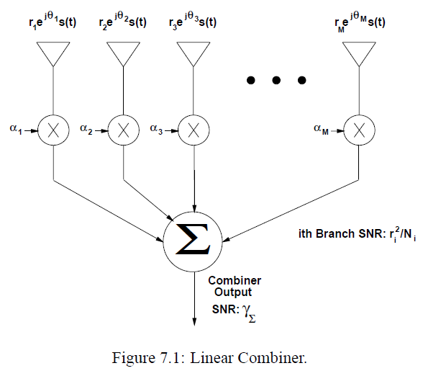

Receive Diversity

Slide 4
Combining Techniques
Selection Combining
  Fading path with highest gain used
Maximal Ratio Combining
  All paths cophased and summed with optimal weighting to maximize combiner output SNR
Equal Gain Combining
  All paths cophased and summed with equal weighting
Array/Diversity gain
  Array gain is from noise averaging (AWGN and fading)
  Diversity gain is change in BER slope (fading)

Slide 5
Selection Combining
Selects the path with the highest gain
Combiner SNR is the maximum of the branch SNRs.
CDF easy to obtain, pdf found by differentiating.
Diminishing returns with number of antennas.
Can get up to about 20 dB of gain.

Slide 6






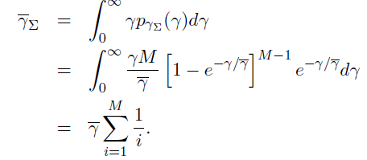
Selection Combining
Rayleigh fading
Same SNR for all:

Slide 7
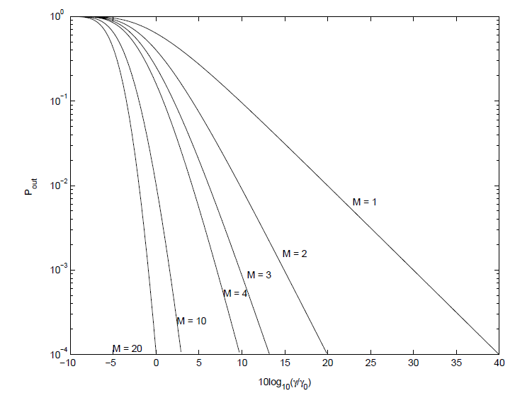
Outage Probability for SC

Slide 8
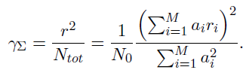




Maximum Ratio Combining
Cophased weight
Optimal weight
i.i.d. Rayleigh
Outage Prob.
chi-squared

Slide 9
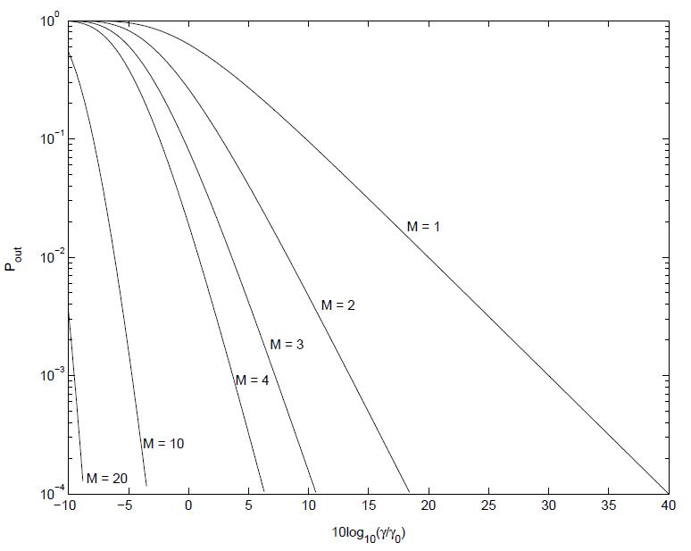
Outage Probability for MRC

Slide 10
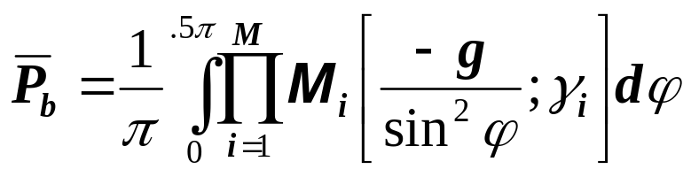
MRC and its Performance
With MRC, γ_{Σ}=Σγ_{i} for branch SNRs γ_{i}
  Optimal technique to maximize output SNR
  Yields 20-40 dB performance gains
  Distribution of γ_{Σ} hard to obtain
Standard average BER calculation
  Hard to obtain in closed form
  Integral often diverges
MGF Approach

Slide 11



Equal-Gain Combining
Equal weight
No closed-form in general for CDF
2-branch i.i.d. Rayleigh
Outage Prob.

Slide 12
EGC and Transmit Diversity
EGQ simpler than MRC
  Harder to analyze
  Performance about 1 dB worse than MRC
Transmit diversity
  With channel knowledge, similar to receiver diversity, same array/diversity gain
  Without channel knowledge, can obtain diversity gain through Alamouti scheme: works over 2 consecutive symbols

Slide 13
Transmit Diversity
Multiple Tx antennas w/ power constraint
Complex channel gain known at Tx
Channel unknown at Tx

Slide 14


Channel Known
Similar to receive MRC diversity
Gain at each antenna
Optimal weight w/ energy constraint 1
Resultant SNR

Slide 15





Channel Unknown
Alamouti Code for two Tx antenna
  Tx s₁ and s₂ per antenna w/ half energy
  Tx –s₂* and s₁* per antenna w/ half energy

Slide 16
Main Points
Diversity typically entails some penalty in terms of rate, bandwidth, complexity, or size.
Techniques trade complexity for performance.
  MRC yields 20-40 dB gain, SC around 20 dB.
Analysis of MRC simplified using MGF approach
EGC easier to implement than MRC: hard to analyze.
  Performance about 1 dB worse than MRC
Transmit diversity can obtain diversity gain even without channel information at transmitter.

